Slide 1
CSCE430/830 Computer Architecture
Instruction-level parallelism: Introduction
Lecturer: Prof. Hong Jiang
Courtesy of Yifeng Zhu (U. Maine)
Fall, 2006
Portions of these slides are derived from:
Dave Patterson © UCB

Slide 2
Class Exercise
Consider the following code segment
LW R1, 0(R4)
LW R2, 0(R5)
ADD R3, R1, R2
BNZ R3, L
LW R4, 100(R1)
LW R5, 100(R2)
SUB R3, R4, R5
L: SW R3, 50(R1)
Assuming that
there is no forwarding,
zero testing is being resolved during ID, and
registers can be written in the first half of the WB cycle and also be read in the send half of the same WB cycle,
Question: identify the sources of various hazards in the above code sequence.

Slide 3
Class Exercise
Consider the following code segment
LW R1, 0(R4)
LW R2, 0(R5)
ADD R3, R1, R2
BNZ R3, L
LW R4, 100(R1)
LW R5, 100(R2)
SUB R3, R4, R5
L: SW R3, 50(R1)
Assuming that
there is no forwarding,
zero testing is being resolved during ID, and
registers can be written in the first of the WB cycle and also be read in the send half of the same WB cycle,
Question: identify the sources of various hazards in the above code sequence.

Slide 4
Class Exercise
Consider the following code segment
LW R1, 0(R4)
LW R2, 0(R5)
ADD R3, R1, R2
BNZ R3, L
LW R4, 100(R1)
LW R5, 100(R2)
SUB R3, R4, R5
L: SW R3, 50(R1)
Assuming that
there is forwarding,
zero testing and target address calculation are done during ID
Use compiler techniques to reorder the code (without changing the meaning/semantics of the program) so as to minimize data hazards as much as possible. Assume that no other general purpose registers other than those used in the code, are available.

Slide 5
Class Exercise
Consider the following code segment
LW R1, 0(R4)
LW R2, 0(R5)
ADD R3, R1, R2 (Not Taken)
BNZ R3, L
LW R4, 100(R1)
LW R5, 100(R2)
SUB R3, R4, R5
L: SW R3, 50(R1)
LW R1, 0(R4)
LW R2, 0(R5)
LW R4, 100(R1)
ADD R3, R1, R2
LW R5, 100(R2)
BNZ R3, L
SUB R3, R4, R5
L: SW R3, 50(R1)
Assuming that
there is forwarding,
zero testing and target address calculation are done during ID
Use compiler techniques to reorder the code (without changing the meaning/semantics of the program) so as to minimize data hazards as much as possible. Assume that no other general purpose registers other than those used in the code, are available.

Slide 6
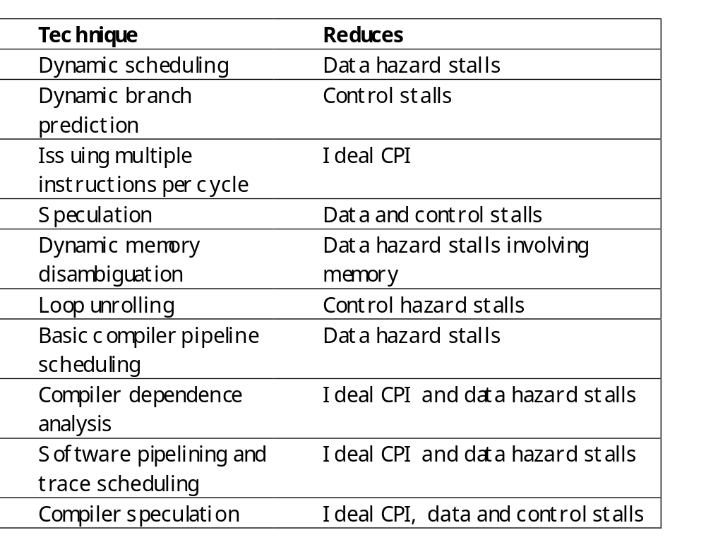
Ideas To Reduce Stalls
Pipeline CPI = Ideal pipeline CPI + Structure stalls + Data hazard stalls + Control stalls
Chapter 3
Chapter 4

Slide 7
Forms of parallelism
Process-level
  How do we exploit it? What are the challenges?
  Examples?
Thread-level
  How do we exploit it? What are the challenges?
  Examples?
Loop-level
  What is really loop level parallelism? What percentage of a program’s time is spent inside loops?
Instruction-level
  Focus of Chapter 3 & 4
Coarse grain
Human intervention?
Fine Grain

Slide 8
Instruction Level Parallelism (ILP)
Principle: There are many instructions in code that don’t depend on each other. That means it’s possible to execute those instructions in parallel.
This is easier said than done. Issues include:
Building compilers to analyze the code,
Building hardware to be even smarter than that code.
This section looks at some of the problems to be solved.

Slide 9
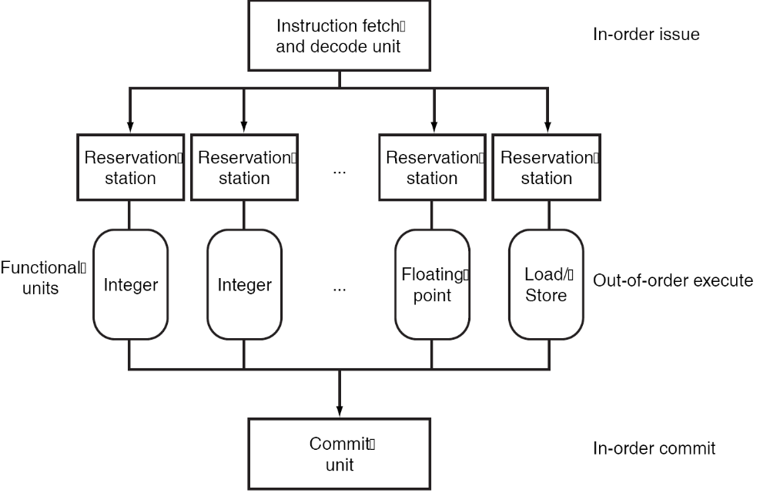
Exploiting Parallelism in Pipeline
Two methods of exploiting the parallelism
  Increase pipeline depth
  Multiple issue
    Replicate internal components
    launch multiple instructions in every pipeline stage
Today’s high-end microprocessor issues 3 to 8 instructions every clock cycle.

Slide 10
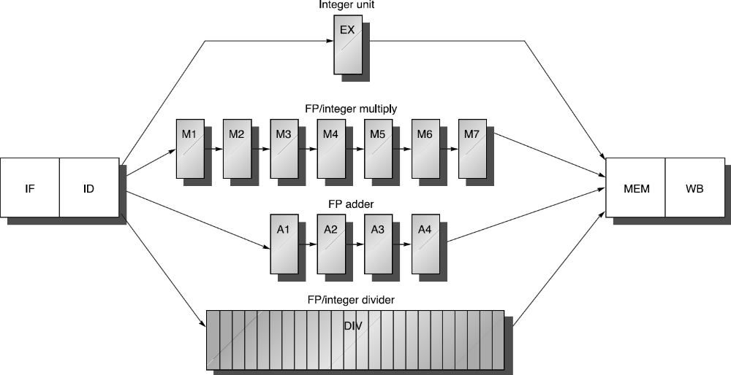
Pipeline supports multiple outstanding FP operations
MULTD
IF
ID
M1
M2
M3
M4
M5
M6
M7
Mem
WB
ADDD
IF
ID
A1
A2
A3
A4
Mem
WB
LD
IF
ID
EX
Mem
WB
SD
IF
ID
EX
Mem
WB

Slide 11
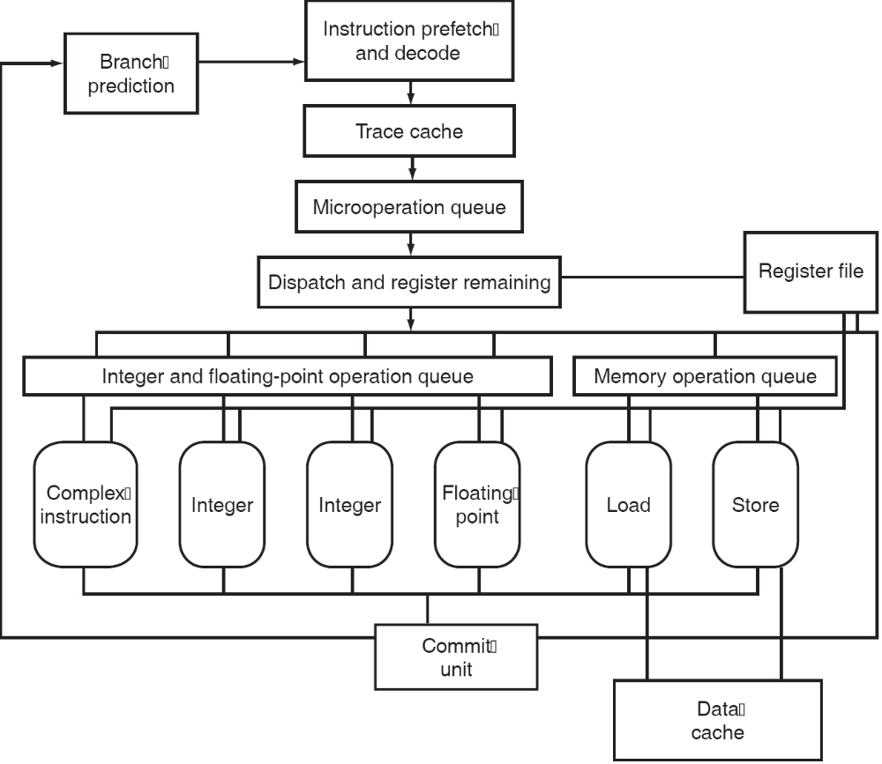
Microarchitecture of Intel Pentium 4

Slide 12
The big picture
Increase pipeline depth
Many decisions are made
by compiler before execution
Parallelism
Static multiple issue
Multiple issue
Dynamic multiple issue
Many decisions are made by hardware during execution

Slide 13
ILP Challenges
How many instructions can we execute in parallel?
Definition of Basic instruction block: What is between two consecutive branch instructions:
  Example: Body of a loop.
  Typical MIPS programs have 15-25 % branch instruction :
    One in every 4-7 instructions is a branch.
    How many of those are likely to be data dependent on each other?
  We need the means to exploit parallelism across basic blocks. What stops us from doing so?

Slide 14
Dependencies
Data dependence
Anti-dependence
Dependence
Name dependencies
Output dependence
Control

Slide 15
Data Dependence and Hazards
Instr_{J} is data dependent on Instr_{I}
Instr_{J} tries to read operand before Instr_{I} writes it
or Instr_{J} is data dependent on Instr_{K} which is dependent on Instr_{I}
Caused by a “True Dependence” (compiler term)
If true dependence caused a hazard in the pipeline, called a Read After Write (RAW) hazard
I: add r1,r2,r3
J: sub r4,r1,r3

Slide 16
Data Dependences through registers/memory
Dependences through registers are easy:
  lw r10,10(r11)
  add r12,r10,r8
  just compare register names.
Dependences through memory are harder:
  sw r10,4 (r2)
  lw r6,0(r4)
  is r2+4 = r4+0? If so they are dependent, if not, they are not.

Slide 17
Name Dependence #1:
Anti-dependence
Name dependence: when 2 instructions use the same register or memory location, called a name, but no flow of data between the instructions is associated with that name; 2 versions of name dependence
Instr_{J} writes operand before Instr_{I} reads it
Called an “anti-dependence” by compiler writers.
This results from reuse of the name “r1”
If anti-dependence caused a hazard in the pipeline, called a Write After Read (WAR) hazard
I: sub r4,r1,r3
J: add r1,r2,r3
K: mul r6,r1,r7

Slide 18
Name Dependence #2:
Output dependence
Instr_{J} writes operand before Instr_{I} writes it.
Called an “output dependence” by compiler writers
This also results from the reuse of name “r1”
If anti-dependence caused a hazard in the pipeline, called a Write After Write (WAW) hazard
I: sub r1,r4,r3
J: add r1,r2,r3
K: mul r6,r1,r7

Slide 19
Dependences and hazards
Dependences are a property of programs.
If two instructions are data dependent they cannot execute simultaneously.
Whether a dependence results in a hazard and whether that hazard actually causes a stall are properties of the pipeline organization.
Data dependences may occur through registers or memory.

Slide 20
Dependences and hazards
The presence of the dependence indicates the potential for a hazard, but the actual hazard and the length of any stall is a property of the pipeline. A data dependence:
  Indicates that there is a possibility of a hazard.
  Determines the order in which results must be calculated, and
  Sets an upper bound on the amount of parallelism that can be exploited.

Slide 21
Instruction Dependence Example
For the following code identify all data and name dependence between instructions and give the dependency graph
1
2
3
4
5
6
L.D F0, 0 (R1)
ADD.D F4, F0, F2
S.D F4, 0(R1)
L.D F0, -8(R1)
ADD.D F4, F0, F2
S.D F4, -8(R1)

Slide 22
Instruction Dependence Example
For the following code identify all data and name dependence between instructions and give the dependency graph
1
2
3
4
5
6
L.D F0, 0 (R1)
ADD.D F4, F0, F2
S.D F4, 0(R1)
L.D F0, -8(R1)
ADD.D F4, F0, F2
S.D F4, -8(R1)
True Data Dependence:
Instruction 2 depends on instruction 1 (instruction 1 result in F0 used by instruction 2), Similarly, instructions (4,5)
Instruction 3 depends on instruction 2 (instruction 2 result in F4 used by instruction 3), Similarly, instructions (5,6)
Name Dependence:
Output Name Dependence (WAW):
Instruction 1 has an output name dependence over result register (name) F0 with instructions 4
Instruction 2 has an output name dependence over result register (name) F4 with instructions 5
Anti-dependence (WAR):
Instruction 2 has an anti-dependence with instruction 4 over register (name) F0 which is an operand of instruction 1 and the result of instruction 4
Instruction 3 has an anti-dependence with instruction 5 over register (name) F4 which is an operand of instruction 3 and the result of instruction 5

Slide 23
Instruction Dependence Example
Dependency Graph
Example Code
1
1
2
3
4
5
6
L.D F0, 0 (R1)
ADD.D F4, F0, F2
S.D F4, 0(R1)
L.D F0, -8(R1)
ADD.D F4, F0, F2
S.D F4, -8(R1)
L.D F0, 0 (R1)
2
ADD.D F4, F0, F2
3
S.D F4, 0(R1)
Date Dependence:
(1, 2) (2, 3) (4, 5) (5, 6)
Output Dependence:
(1, 4) (2, 5)
Anti-dependence:
(2, 4) (3, 5)
4
L.D F0, -8 (R1)
5
ADD.D F4, F0, F2
6
Can instruction 4 (second L.D) be moved
just after instruction 1 (first L.D)?
If not what dependencies are violated?
S.D F4, -8 (R1)
Can instruction 3 (first S.D) be moved
just after instruction 4 (second L.D)?
How about moving 3 after 5 (the second ADD.D)?
If not what dependencies are violated?

Slide 24
ILP and Data Hazards
HW/SW must preserve program order:
the order in which instructions would execute in if executed sequentially 1 at a time as determined by original source program
HW/SW goal: exploit parallelism by preserving program order only where it affects the outcome of the program
Instructions involved in a name dependence can execute simultaneously if name used in instructions is changed so instructions do not conflict
  Register renaming resolves name dependence for registers
  Either by compiler or by HW

Slide 25
Control Dependencies
Every instruction is control dependent on some set of branches, and, in general, these control dependencies must be preserved to preserve program order
  if p1 {
  S1;
  };
  if p2 {
  S2;
  }
S1 is control dependent on p1, and
S2 is control dependent on p2 but not on p1.

Slide 26
Control Dependence Ignored
Control dependence need not be preserved
  willing to execute instructions that should not have been executed, thereby violating the control dependences, if can do so without affecting correctness of the program
  DADDU r2,r3,r4
  beqz r2,l1
  lw r1,0(r2)
  l1:
Can we move lw before the branch? (Don’t worry, it is OK to violate control dependences as long as we can preserve the program semantics)
Instead, 2 properties critical to program correctness are exception behavior and data flow

Slide 27
Preserving the exception behavior
Corollary I:
  Any changes in the ordering of instructions should not change how exceptions are raised in a program.
  → Reordering of instruction execution should not cause any new exceptions.
  DADDU r2,r3,r4
  beqz r2,l1
  lw r1,0(r2)
  l1:

Slide 28
Preserving the data flow
Consider the following example:
  daddu r1,r2,r3
  beqz r4,L
  dsubu r1,r5,r6
  L: …
  or r7,r1,r8
What can you say about the value of r1 used by the or instruction?

Slide 29
Preserving the data flow
Corollary II:
Preserving data dependences alone is not sufficient when changing program order. We must preserve the data flow.
Data flow: actual flow of data values among instructions that produce results and those that consume them.
These two corollaries together allow us to execute instructions in a different order and still maintain the program semantics.
This is the foundation upon which ILP processors are built.

Slide 30
Speculation
DADDU R1, R2, R3
BEQZ R12, skipnext
DSUBU R4, R5, R6
DADDU R5, R4, R9
skipnext OR R7, R8, R9
Assume R4 is dead (rather than live) after skipnext.
We can execute DSUBU before BEQZ since
  R4 could not generate an exception.
  The data flow cannot be affected.
This type of code scheduling is called speculation.
  The compiler is betting on the branch outcome. In this case, the bet is that the branch is usually not take.

Slide 31
Summary
Two critical properties to maintain program correctness:
  1. Any changes in the ordering of instructions should not change how exceptions are raised in a program.
  2. The data flow is preserved.

